Slide 1
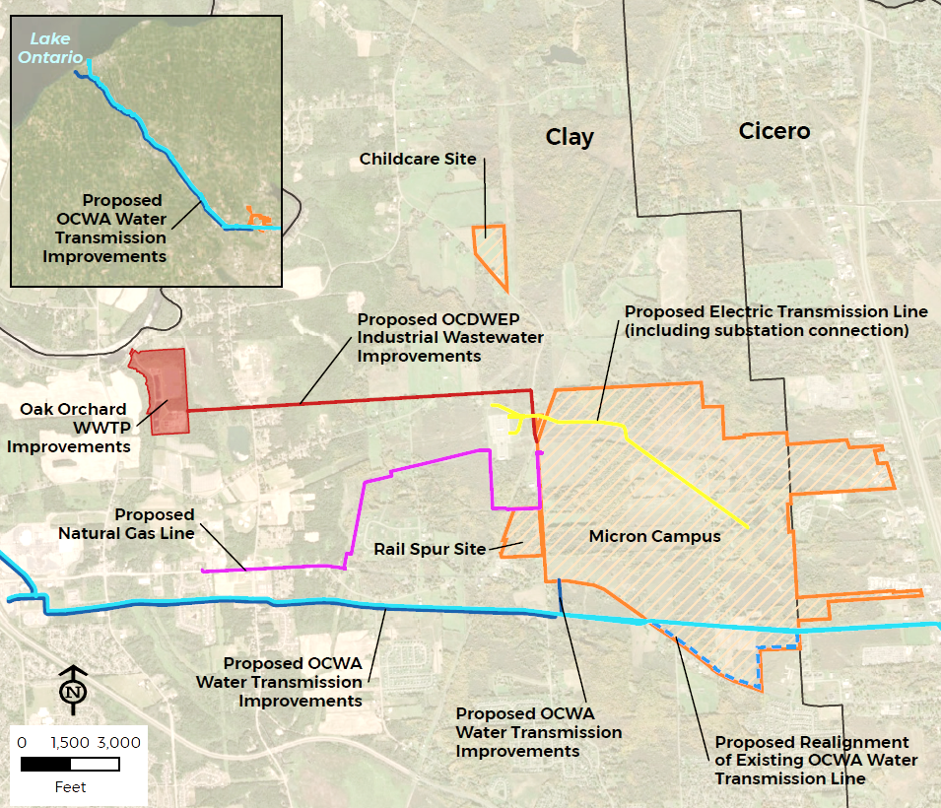
public scoping Meeting for Micron Semiconductor Facility, Clay, NY
Environmental impact Statement
March 19, 2024
Clay, NY

Slide 2
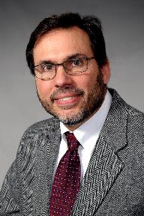
CONVERSATION/Meeting NORMS
Please turn cell phones to vibrate or silent
      Please leave the room if you need to take a call.
Please allow others to talk
      Do not interrupt or talk over one another.
      Refrain from sidebar conversations that may distract others from listening to commenters.
      Refrain from applause.
Please treat each other with respect
Meeting Facilitator
Steven Metivier
Chief, Regulatory Branch
Buffalo District, U.S. Army Corps of Engineers
Notes:
***REMOVE COVID NOTES FOR VIRTUAL MEETING***

Slide 3
Safety Reminders
Note the nearest emergency exit.
Notify meeting personnel if you have any security-related concerns during this evening’s meeting.
Keep signs, banners, and posters outside — the facility has established a designated area outside where individuals can safely display signage without impeding the flow and emergency exit procedures.

Slide 4
Meeting Agenda
Opening Remarks
Corps of Engineers Permit Review
National Environmental Policy Act (NEPA)
Environmental Impact Statement (EIS) Scoping Process
EIS Process
Public Comment Information
Proposed Project Overview (Micron)
Open for Public Comment
Closing Remarks

Slide 5
Corps OF ENGINEERS Permit Review
Authority: Section 404 of the Clean Water Act
Regulatory Program Regulations: Code of Federal Regulations Title 33, Parts 320-332
Review Components:
      Public Interest Review
      Clean Water Act Section 404(b)(1) Guidelines
      National Environmental Policy Act (NEPA)
      Section 7 of the Endangered Species Act
      Section 106 of the National Historic Preservation Act
      Tribal Consultation

Slide 6
National Environmental Policy Act
The National Environmental Policy Act (NEPA) requires federal agencies to take a “hard look” at the potential effects of their actions, including permit decisions, prior to making decisions.
NEPA ensures that the agency’s decisions are appropriately informed but does not mandate a particular decision.
NEPA requires agencies to provide opportunities for public review and comment.
An Environmental Impact Statement (EIS) is prepared under NEPA for projects that are likely to have significant effects to the environment.
An EIS provides full and fair discussion of environmental impacts of an action and reasonable alternatives, as well as measures to minimize and mitigate impacts.

Slide 7
Agency Roles
The U.S. Army Corps of Engineers (USACE) is the lead federal agency for the Micron Project Environmental Impact Statement.
Other Cooperating and Participating federal agencies
  U.S. Department of Commerce CHIPS Program Office(CHIPS)
  United States Fish and Wildlife Service (USFWS)
  Federal Highways Administration (FHWA)
  U.S. Environmental Protection Agency (EPA)

Slide 8
Potential Environmental FACTORS
FOR ANALYSIS
Land use
Socioeconomic Conditions
Environmental Justice Communities
Historic and Cultural Resources
Visual Impacts
Geology, Soils, and Topography
Water Resources
Fish and Wildlife Values
Endangered Species
Wetland and stream impacts
Solid waste
Hazardous material
Transportation
Air Quality
Greenhouse Gas Emissions and Climate Change
Noise
Utilities and Infrastructure

Slide 9
Scoping
Scoping provides interested parties an opportunity to provide comments to inform the Draft EIS.
Comments help to:
      Identify issues for in-depth analysis in the EIS
      Identify alternatives to be considered in the EIS
            USACE invites input from Federal agencies, tribal nations, state, and local governments, the general public, and the commercial community to comment on the scope of the EIS.
            USACE invites comment on the identification of reasonable alternatives and information and analyses relevant to the Proposed Action and specific environmental issues to be addressed.
            All public scoping comments, verbal and written, will be part of the official record and a summary will be included in the Draft EIS.

Slide 10
EIS PROCESS
Scoping Period: March 5- April 4, 2024
Preparation of Draft EIS
Draft EIS Comment period: 45 days from Notice of Availability of DEIS (Federal Register) and will include public meeting.
Final EIS:
Final EIS Waiting Period: Minimum 30 days from Notice of Availability for Final EIS (Federal Register)
Record of Decision:
Green:
Opportunity for Public Comment

Slide 11
How to Provide Comments
Comment Period is open from March 5- April 4, 2024
Three different ways to comment (only need to do 1):
1. Oral comments during tonight’s scoping meeting
2. E-mail: Submit via e-mail to:
celrb-micron.public.comments@usace.army.mil
3. Mail: Comments can also be mailed to the USACE, Buffalo District at:
  U.S. Army Corps of Engineers, Buffalo District
  Attn: Ms. Margaret Crawford
  7413 County House Road
  Auburn, New York 13021

Slide 12
Micron NY Project Overview
Notes:
Exploratory

Slide 13
Transforming how the world uses information to enrich life for all
Founded on
October 5, 1978
Engaged team members
Leading-edge products
Responsible operations
Headquartered in
Boise, Idaho, USA
Front-end manufacturing sites
Assembly and test manufacturing sites
Micron offices
$15.5B
FY2023 revenue
Canada
China
Europe
South Korea
One of the largest semiconductor companies
in the world
United States
Japan
Taiwan
India
Singapore
~4 4,000
team members
Malaysia

Slide 14
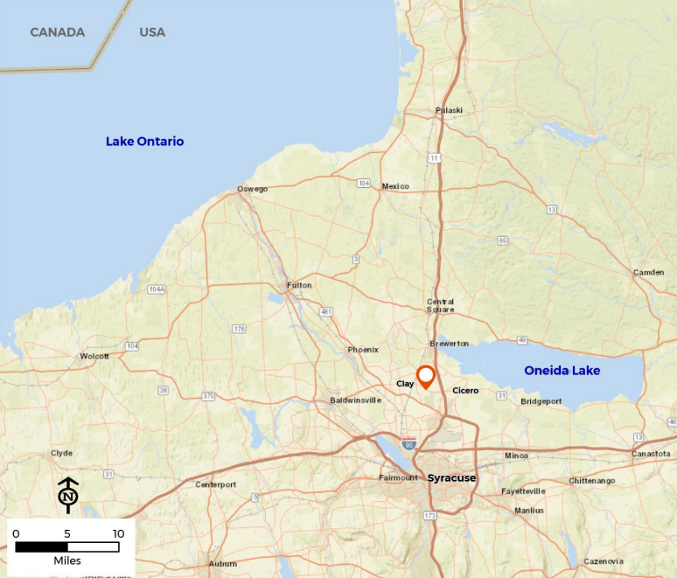
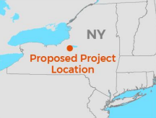

Micron NY – Vicinity Map

Slide 15
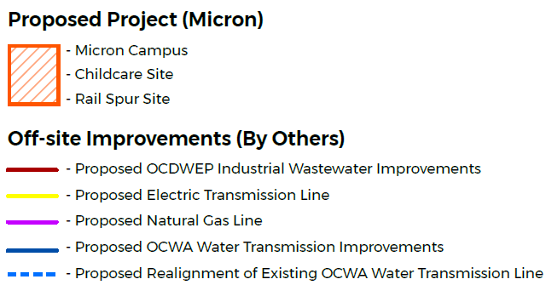
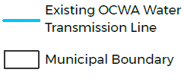
Micron NY – Overview Map

Slide 16
Proposed Project

Slide 17
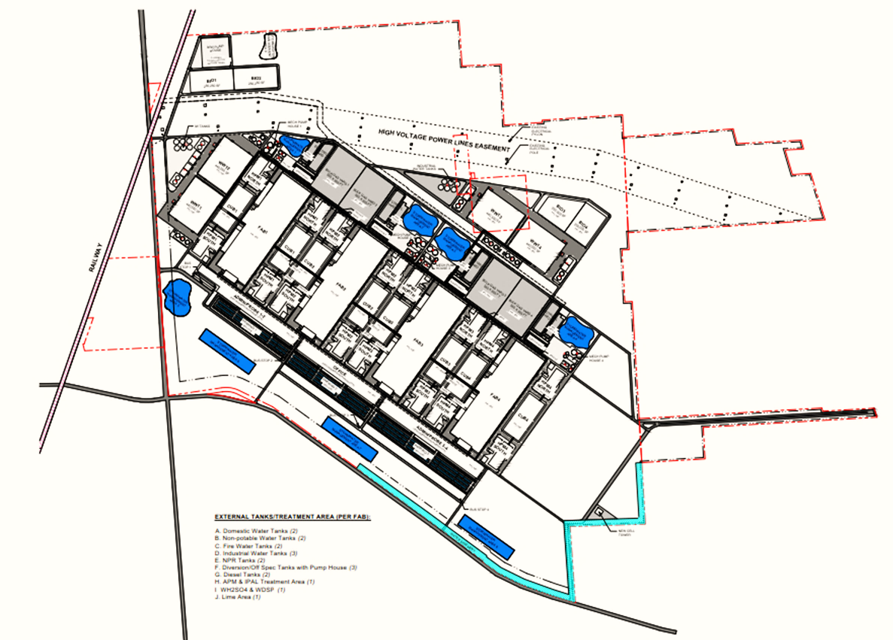
Micron NY – Proposed Project Elements
Main Site
  +/- 1,400 ac parcel assemblage at NYS Route 31 & Caughdenoy Road (including “jack and bore” site)
  Fab 1: Start Construction CY 2025
  Fab 2: Operational by CY 2029
  Fab 3: Operational by CY 2035
  Fab 4: Operational by CY 2041
  Each Fab will have +/- 600k sf cleanroom, 290k sf cleanroom support, 250k sf admin space
  Each set of 2 Fabs will have +/- 470k sf central utility, 200k sf warehouse, 200k sf product testing
  Campus will have ancillary on-site electrical substations, facilities for water and wastewater treatment and storage, and industrial gas storage.

Slide 18
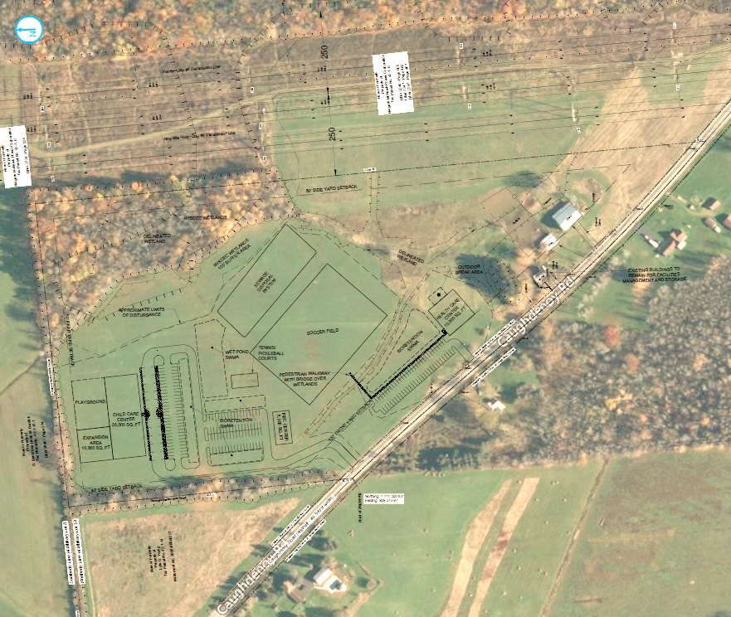
Micron NY – Proposed Project Elements
Childcare Site
  30.2 ac parcel at 9100 Caughdenoy Road for childcare and employee/family health care facility

Slide 19
Offsite Improvements

Slide 20
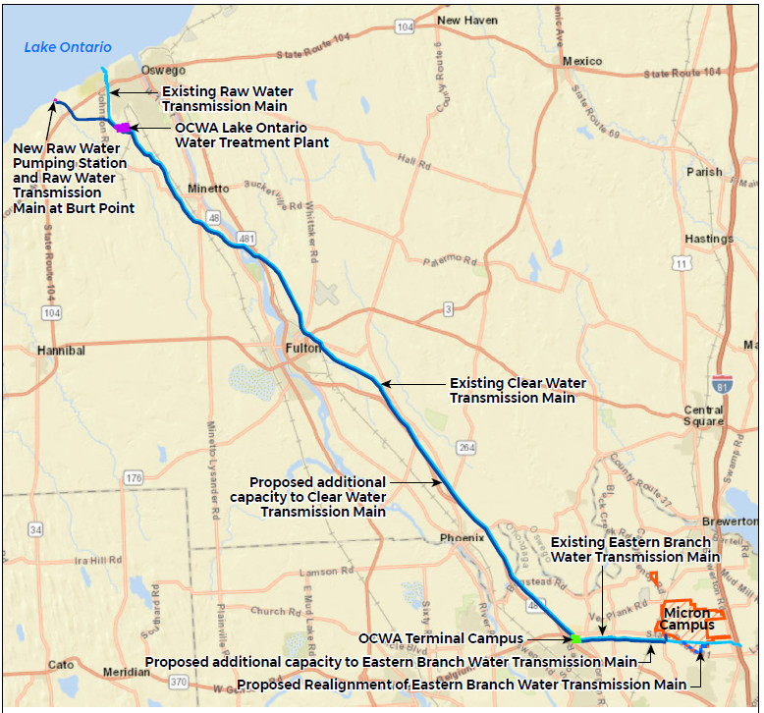
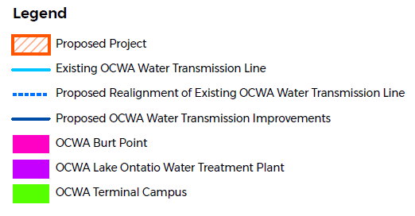
Offsite Improvements – Water Supply (OCWA)
Note:
Existing and proposed water transmission improvements will be located within the same approximately 99-foot-wide ROW; in easements already obtained by OCWA.
New line (water tunnel) to Burt Point would also go through existing ROW but that ROW has not been previously disturbed ROW.

Slide 21
Offsite Improvements – Wastewater (OCDWEP)
Wastewater
  Operation of Micron’s Fabs 1-4 will require additional industrial wastewater infrastructure and improvements to the Oak Orchard WWTP
    Construction of OCDWEP industrial wastewater service conveyance to the Oak Orchard wastewater treatment plant (WWTP) from a new industrial wastewater pumping station to be constructed on the Micron Campus.
    Conveyance infrastructure would comprise four (4) 30-inch force mains for industrial wastewater; and one (1) 36-inch force main for reclaimed water supply
    Expansion of the Oak Orchard WWTP to treat industrial wastewater (with pre-treatment required by Micron at the Micron Campus).

Slide 22
Offsite Improvements – Natural Gas (NG)
Natural Gas
  Extension of a 16-inch diameter natural gas line from National Grid’s Gas Regulator Station (GRS) 147 at 4459 NYS Route 31 to the Micron Campus (approximately 3.15 miles)
  Construction of GRS 147A at the same address as the existing GRS

Slide 23
Offsite Improvements – Electricity (NG)
Electricity
  Construction of eight (two per Fab) underground electrical transmission duct bank connections from the existing National Grid sub-station west of Caughdenoy Road

Slide 24
Offsite – Fiber
Fiber
  Providers in the area have existing fiber connection points for the project that are within 1 mile of the two points of connections to the Micron campus (3,700 ft from existing point in Cicero and 3,200 ft from existing point in Clay)
  Routes would be built along existing road right of ways.

Slide 25
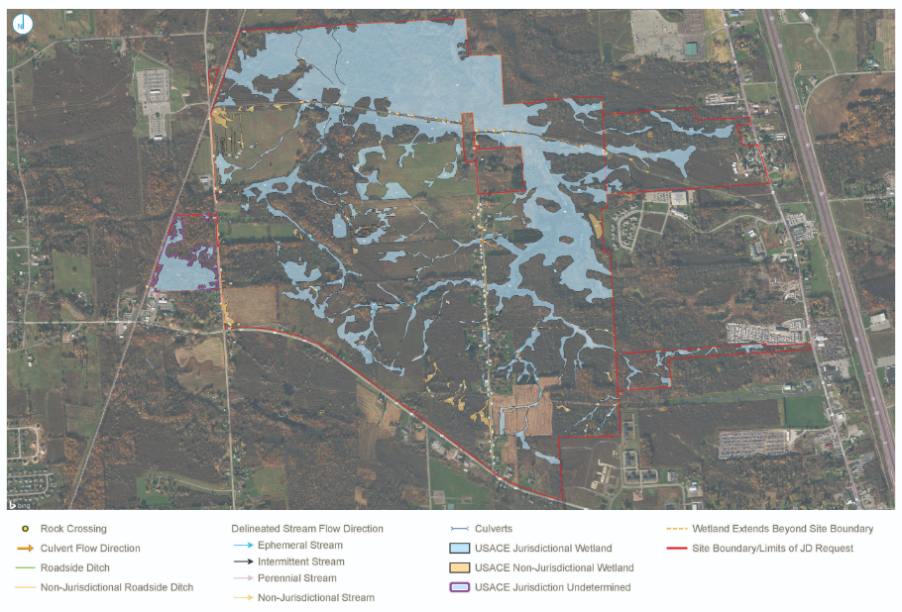
Wetlands
Micron is coordinating with federal and state agencies to conduct detailed site evaluations of wetlands on the project site. In consultation with the U.S. Army Corps of Engineers (USACE) and New York State Department of Environmental Conservation (NYSDEC), Micron conducted field inspections in Spring 2023, Fall 2023, and Winter 2024 to identify Federal and State wetlands on the project site.
The proposed Micron Campus contains portions of NYS mapped wetlands BRE-11 and BRE-14, part of the Youngs Creek watershed.
Off-site utility corridors will also be evaluated. The proposed alignment for industrial wastewater force mains crosses NYSDEC wetland BRE-09 and BRE-13.
USACE and NYSDEC staff have completed the review of the field-delineated wetlands. USACE has issued jurisdictional determination for the main site.

Slide 26
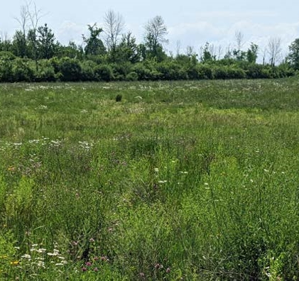
Wetlands
As currently proposed, the proposed project will result in impacts to approximately 244 acres of federally regulated wetlands and approximately 7,523 linear feet of federally regulated streams and ditches, requiring a permit from the USACE under Section 404 of the Clean Water Act.
Compensatory mitigation to offset permanent losses of waters of the United States will be included in a revised Joint Permit Application to USACE and NYSDEC.
Micron is working to develop mitigation plans for expected impacts to federal or state wetlands, as well as for the loss of bat habitat and grassland bird habitat.
Additional details on wetland impacts and mitigation plans will be disclosed in the NEPA Environmental Impact Statement.

Slide 28
How to Provide Comments
Comment Period is open from March 5- April 4, 2024
Three different ways to comment (only need to do 1):
1. Oral comments during tonight’s scoping meeting
2. E-mail: Submit via e-mail to:
celrb-micron.public.comments@usace.army.mil
3. Mail: Comments can also be mailed to the USACE, Buffalo District at:
  U.S. Army Corps of Engineers, Buffalo District
  Attn: Ms. Margaret Crawford
  7413 County House Road
  Auburn, New York 13021

Slide 29
Verbal Commenting
Say and spell your first and last name at the start of your comment.
Speak clearly into the microphone.
The Corps of Engineers will not respond to comments or questions during the meeting. All comments will be considered during preparation of the EIS.
Verbal comments will be held to a time limit.
If time allows, participants may be permitted to speak again after all commenters have an initial opportunity to speak.
This meeting is being transcribed, and all comments will be included in the administrative record.

Slide 30
Opening Remarks
Steven Metivier
Chief, Regulatory Branch
Buffalo District, U.S. Army Corps of Engineers

